Slide 1
Morbidity & Mortality Trends in Saint Lucia 2000-2024
National Wellness and Productivity Workshop
May 22-23, 2025
Harbor Club, Saint Lucia
Dr. Michelle François
National Epidemiologist
Ministry of Health, Wellness & Elderly Affairs
Prepared by the Epidemiology Unit

Slide 2
CONTENTS
Demography
Morbidity
Determinants of Health
Mortality

Slide 3
DEMOGRAPHY
Population: Age and Gender, District
Life Expectancy
Demographic Determinants: Fertility Rates

Slide 4
Population by Age Group and Gender, 2022 (census)
Census 2022 has estimated the population of Saint Lucia to be 171,834 for 2022.
Children (<15 years) represent about 19% and the elderly (65 years or older) 12%.
 | Males |  | Females |  | Total
 | # | % | # | % | # | %
<1 | 923 | 0.5% | 839 | 0.5% | 1762 | 1.0%
1-4 | 4,117 | 2.4% | 3,997 | 2.3% | 8114 | 4.7%
5-14 | 11,268 | 6.6% | 11,179 | 6.5% | 22,448 | 13.1%
15-24 | 11,889 | 6.9% | 11,363 | 6.6% | 23,252 | 13.5%
25-44 | 25,001 | 14.5% | 26,291 | 15.3% | 51,293 | 29.9%
45-64 | 22,023 | 12.8% | 22,362 | 13.0% | 44,385 | 25.8%
65 or Older | 9,493 | 5.5% | 11,089 | 6.5% | 20,581 | 12.0%
Total | 84, 714 | 49.3% | 87, 120 | 50.7% | 171, 834 | 100.0%

Slide 5
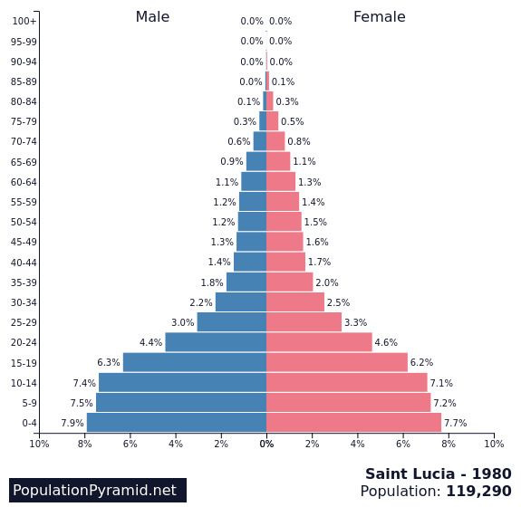
Saint Lucia Population Pyramid
Saint Lucia Population Pyramid 2022
Saint Lucia Population Pyramid 2020
Saint Lucia Population Pyramid 1980
Source: St. Lucia 2022 Population and Housing Census Provisional Results

Slide 6
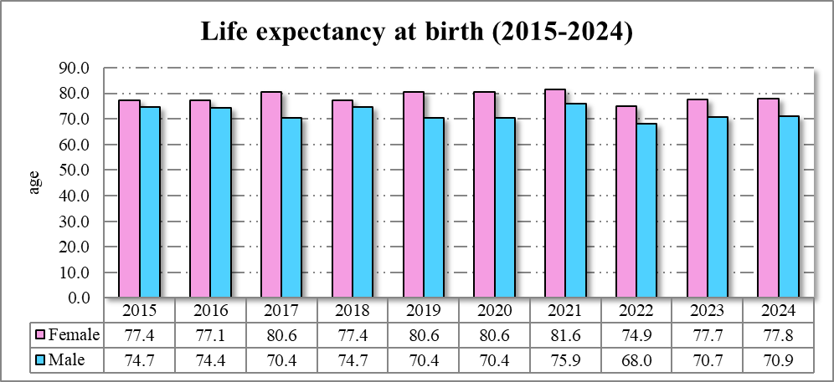
LIFE EXPECTANCY BY SEX
In keeping with global trends, women consistently outlive men.
In 2024, women outlived men by 7 years.
This may be a combination of genetics, social behaviors and health-seeking behaviors
Source: Epidemiological Trend Indicators Database, Epi Unit, Saint Lucia

Slide 7
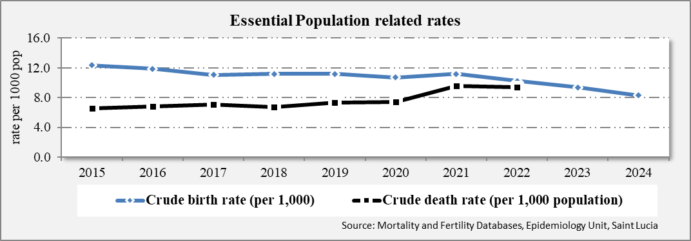
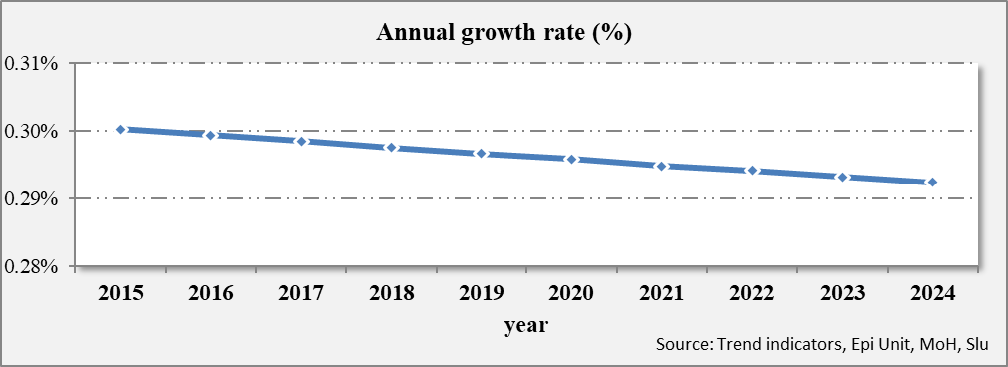
Saint Lucia Population growth rate
Trends in Crude Birth Rates (CBRs) and Crude Death Rates (CDRs), 2015 - 2024
Annual growth rate of mid-year population, 2011 to 2020
Source: Epidemiology Unit, MoH, Saint Lucia
Notes:
The crude birth rate is the annual number of live births per 1,000 population. Generally speaking, a country’s birth rate declines as it becomes more developed. This is due to many factors like higher education rates for women (and thus more women in the workforce), greater access to contraceptives and family planning, as well as higher childbearing costs.
Total fertility rate (TFR) compares figures for the average number of children that would be born per woman if all women lived to the end of their childbearing years and bore children according to a given fertility rate at each age. TFR is a more direct measure of the level of fertility than the crude birth rate, since it refers to births per woman.

Slide 8
Total Fertility Rate
Replacement fertility is the TFR at which women give birth to enough babies to sustain population levels; replacement fertility should be approximately 2.1
A country’s birth rate declines as it becomes more developed. This is due to many factors like higher education rates for women (and thus more women in the workforce), greater access to contraceptives and family planning, as well as higher childbearing costs.
Replacement level
Source: Epidemiology Unit, MoH, Saint Lucia
Notes:
Total fertility rate (TFR) compares figures for the average number of children that would be born per woman if all women lived to the end of their childbearing years and bore children according to a given fertility rate at each age. TFR is a more direct measure of the level of fertility than the crude birth rate, since it refers to births per woman

Slide 9
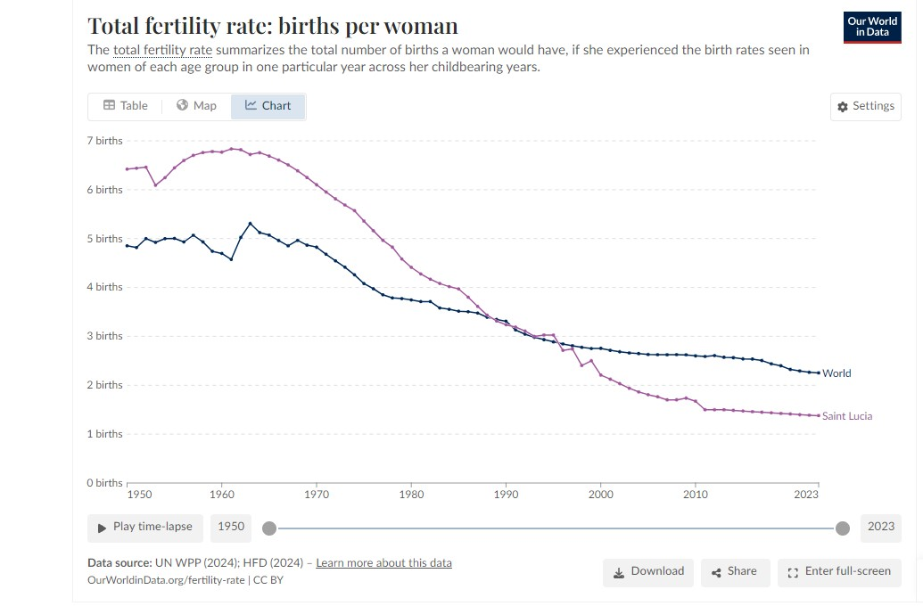
Total Fertility Rate – Global & Local
According to the United Nations, the global fertility rate stands at 2.25 live births per woman, 1 down from 3.31 births in 1990.
More than half of all countries and areas globally have fertility below the replacement level of 2.1 live births per woman

Slide 10
Morbidity
Hospitalizations
Non-Communicable Diseases
Communicable Diseases

Slide 11
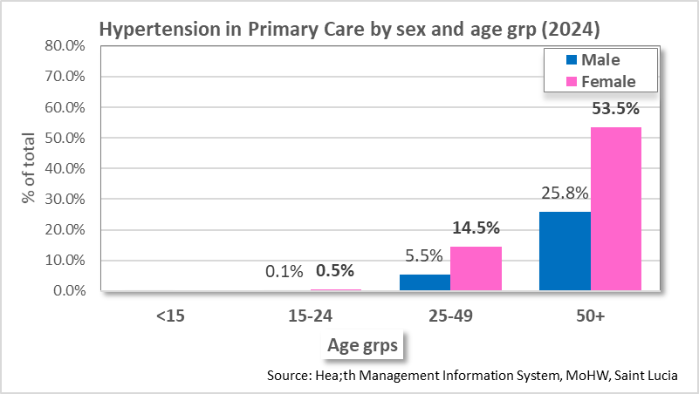
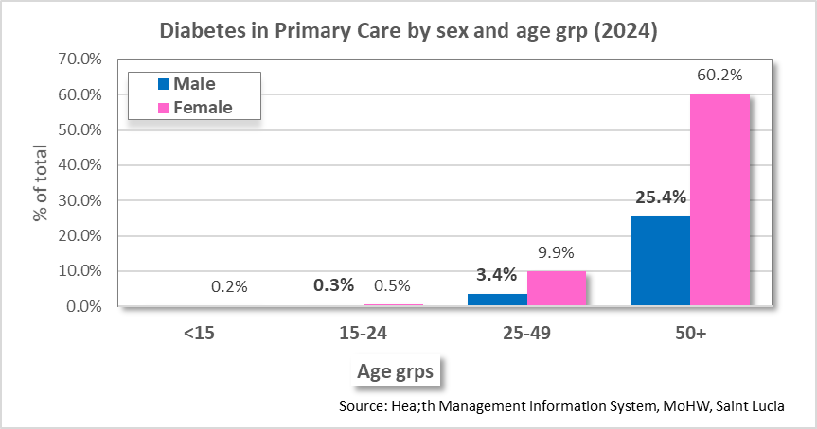
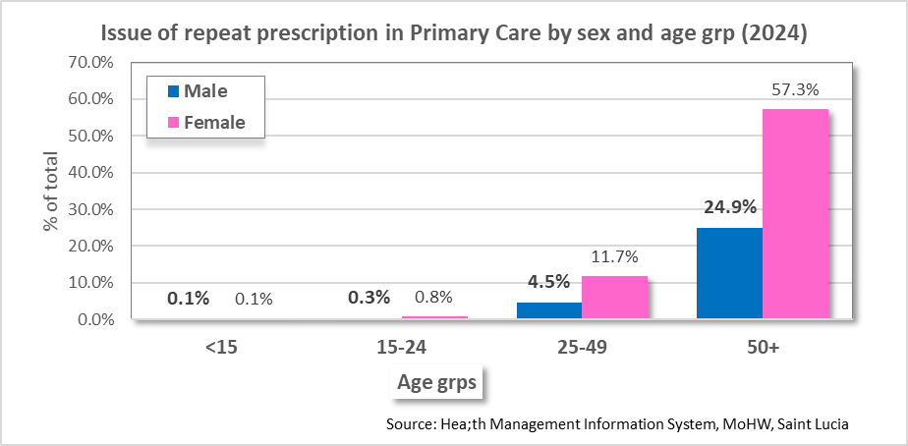
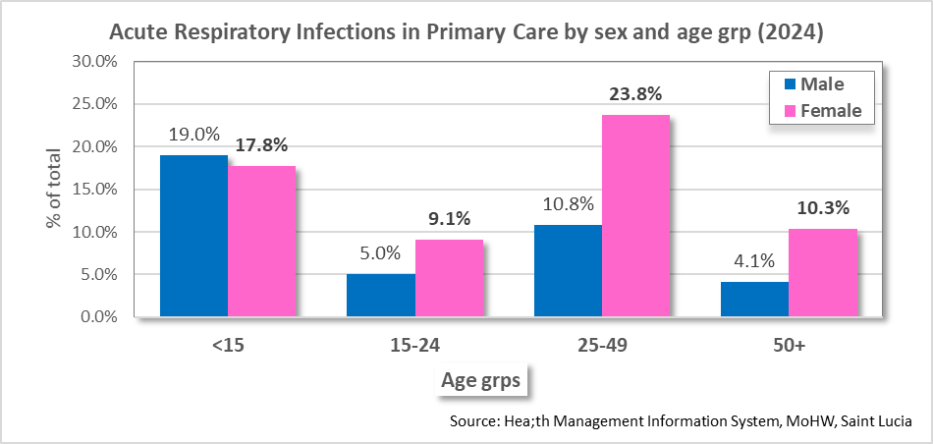
Morbidity: Top 10 reasons for Individuals Accessing Primary Care
The top 3 reasons for accessing Primary Care were the same for 2020 – 2024
Increasing cases of gastroenteritis which is reflected in the numbers reported during weekly Syndromic Surveillance
2020 | 2021 | 2022 | 2023 | 2024 | 2025(May)
Hypertension | Issue of repeat prescription | Hypertension | Acute upper respiratory infection | Hypertension | Issue of repeat prescription
Issue of repeat prescription | Hypertension | Issue of repeat prescription | Hypertension | Acute upper respiratory infection | Hypertension
Acute upper respiratory infection | Acute upper respiratory infection | Acute upper respiratory infection | Issue of repeat prescription | Issue of repeat prescription | Acute upper respiratory infection
Dengue fever | Examination of ears and hearing | Urinary tract infection | Acute nasopharyngitis | Diabetes Mellitus | Acute nasopharyngitis
Acute nasopharyngitis | General medical examination | Low back pain | Diarrhoea and gastroenteritis | Diarrhoea and gastroenteritis | Urinary tract infection
Fever, unspecified | Urinary tract infection | Examination of ears and hearing | Urinary tract infection | Acute nasopharyngitis | Acute tonsillitis
Viral infection | Low back pain | General medical examination | Acute tonsillitis | Urinary tract infection | Cough
Urinary tract infection | Secondary hypertension | Diarrhoea and gastroenteritis | Diabetes mellitus | Viral infection | Acute lower respiratory infection
Acute tonsillitis | Non-insulin-dep. diabetes mellitus | Rashs | Acute lower respiratory infection | Cough | Diarrhoea and gastroenteritis
Rashs | Rashs | Gastritis, unspecified | Cough | General medical examination | Low back pain

Slide 12
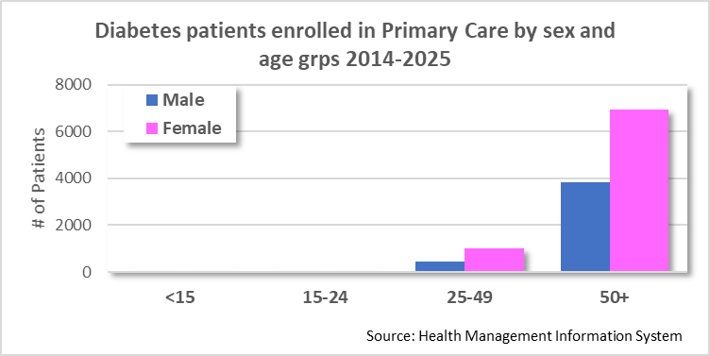
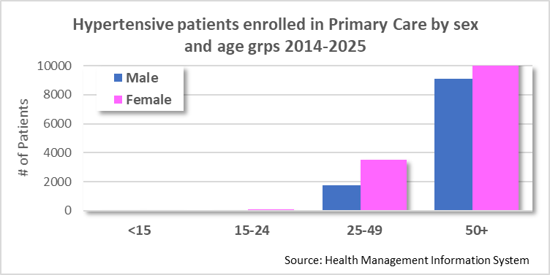
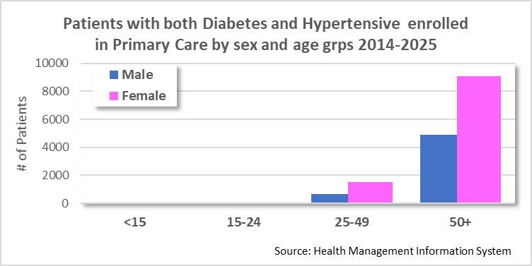
Morbidity (Primary Care): Diabetics & Hypertensive Cases enrolled in Public Health Care Facilities (May, 2025)
Diabetes
Total number enrolled 2014-2025 (May): 12,334
Females account for 65%
50+ age group accounts for 87%
Hypertension
Total number enrolled 2014-2025 (May): 29,223
Females account for 63%
50+ age group accounts for 81%
Diabetes and Hypertension
Total number enrolled 2014-2025 (May): 16,271
Females account for 66%
50+ age group accounts for 86%

Slide 13
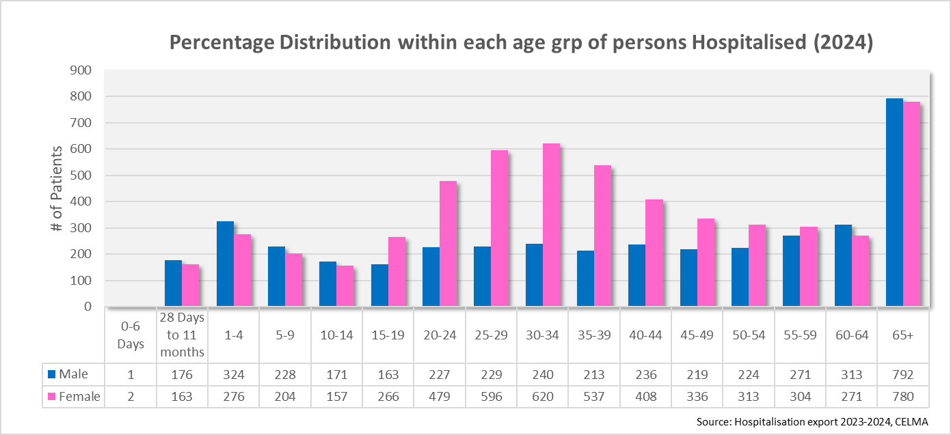
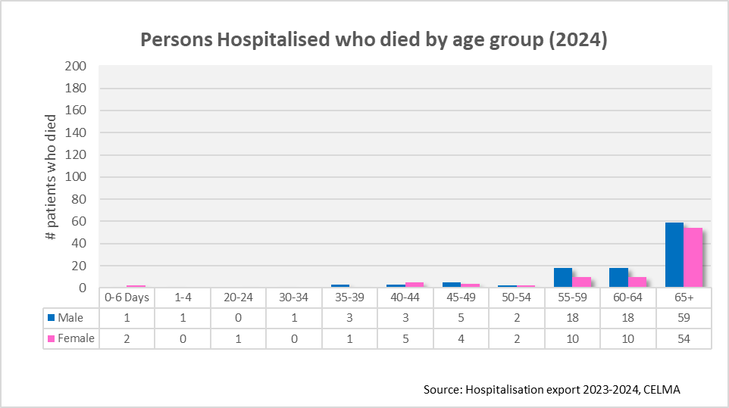
Morbidity: Secondary Care Level (Hospital Admissions 2024)
In 2024, hospitalization rate was 563.1 admissions per 10,000 population (n=9, 739)
This was a 23.5% decrease from the previous year 2023 (n=12, 723).
59% of the total admission were female.
The 25-49 accounted for 37.3% of all admissions with females being 19.1% higher than males in that age group.
The vulnerable age groups of <4 and 65+ accounted for 25.8% of all admissions.
A total of 200 deaths occurred at the hospitals representing an admission fatality rate of 2.1%.
Approximately 56% of those who died were men and 57% of total deaths were 65+.
Notes:
2024 Admissions
65+ : males: Hypertension, Urinary Tract Infections, Observation for other suspected diseases and conditions, Unspecified haematuria, Congestive heart failure, acute lower respiratory infection
Females: Hypertension, Diabetes, Observation for other suspected diseases and conditions, Congestive heart failure, Gastrointestinal haemorrhage, Urinary tract infection, Gastritis

Slide 14
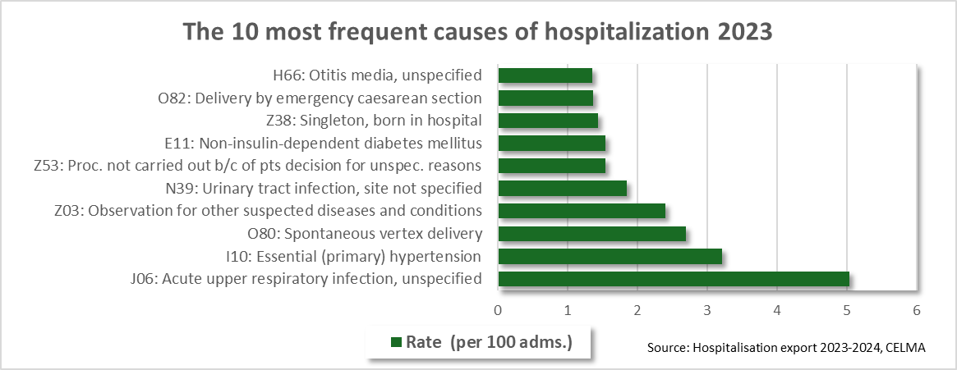
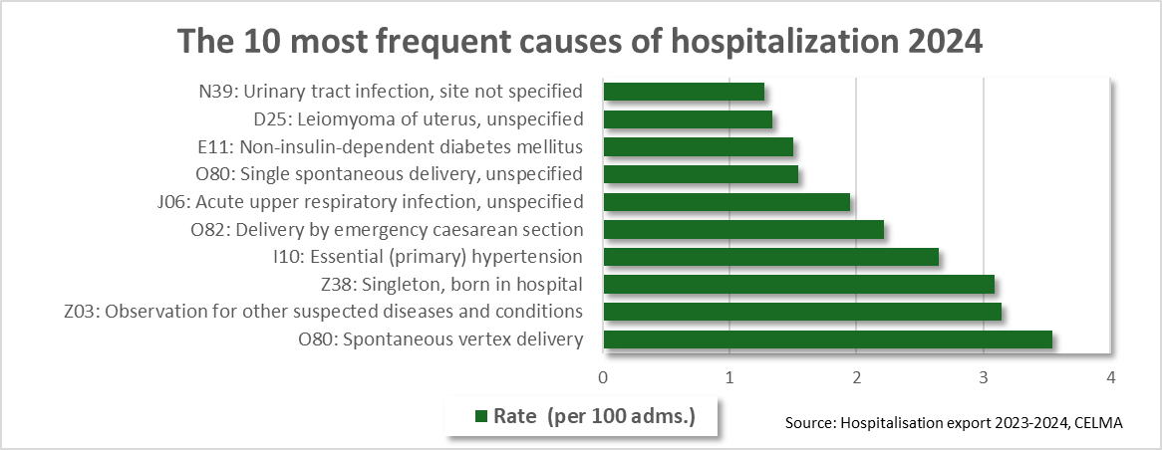
Morbidity: Secondary Care (Hospital Admissions 2023 and 2024)
Top 10 causes accounted for 25% of admissions for each year
Females accounted for 69% in 2023 and 71% in 2024
Highest % of admissions were in the 25-49 age grp for each year (37% resp.) (Mainly due to Deliveries)
Notes:
In 2023, we saw significant numbers of influenza and RSV.
Z03.8 might be used: A patient with a new rash is seen by a doctor, but after observation, the rash is determined to be a normal reaction to a recent skin product.

Slide 15
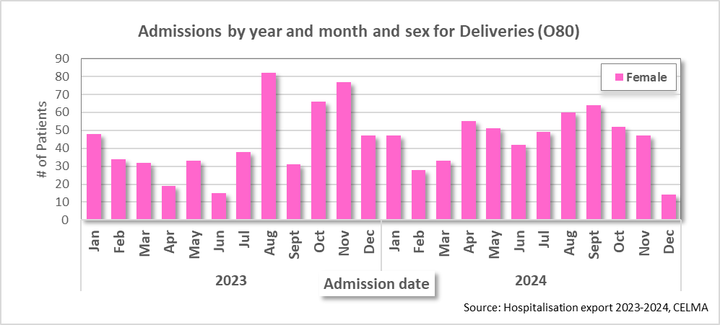
Morbidity: Secondary Care (Hospital Admissions 2023 and 2024) -Admissions by Predominant cause of Hospitalization Delivery related admissions
Delivery related admissions averaged 44 and 45 per month for 2023 and 2024 resp.
Occurred at a rate of 4 per 100 admissions for 2023 and 3 per 100 admissions for 2024
Most delivery related admissions seem to occur between Aug-Oct

Slide 16
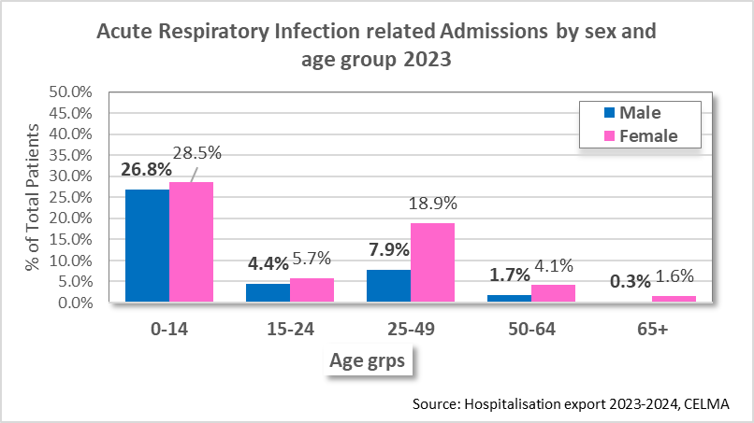
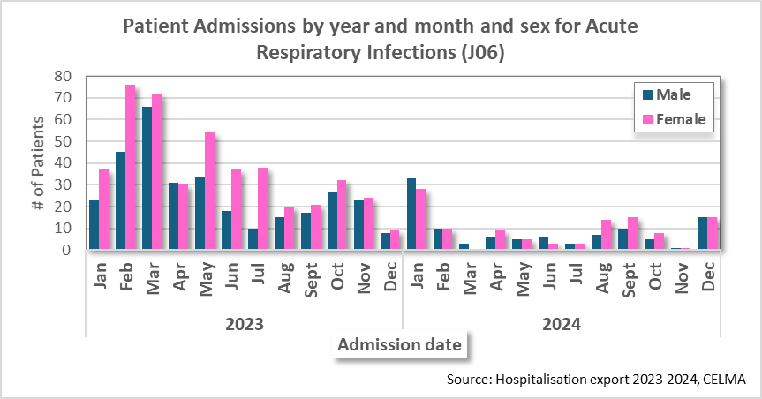
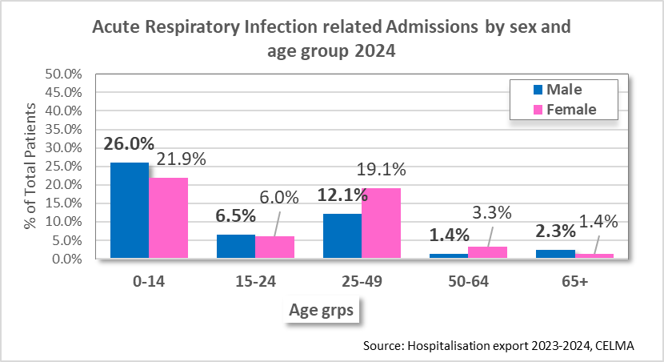
Morbidity (Hospital Admissions 2023 and 2024) -Admissions by Date for Predominant reasons for Hospitalization Acute Respiratory Infection
Acute Respiratory Infection admissions averaged 64 and 20 per month for 2023 and 2024 resp.
Occurred at a rate of 6 per 100 admissions for 2023 and 2 per 100 admissions for 2024
Approximately 1/3rd of Admissions of Acute Respiratory Infections occurred between the months of January-March
More females than males were admitted for each year (59% and 52% resp.)
Age group 0-14 was the most affected for both years.

Slide 17
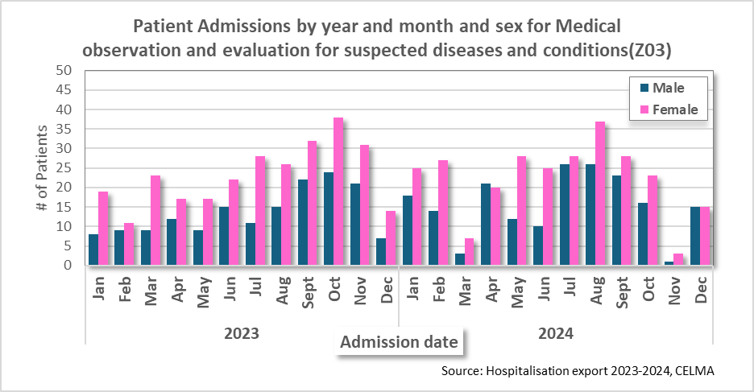
Morbidity (Hospital Admissions 2023 and 2024) -Admissions by Date for Predominant reasons for Hospitalization
Z03
Z03 covers observation for suspected diseases and conditions such as TB, Cancer, mental, behavior and nervous
systems disorders, MI’s and Cardiovascular disorders.
Admissions averaged 37 and 38 per month for 2023 and 2024 resp.
Occurred at a rate of 3 per 100 admissions for 2023 and 2024 resp.
More females than males were admitted for each year (63% and 58% resp.)

Slide 18
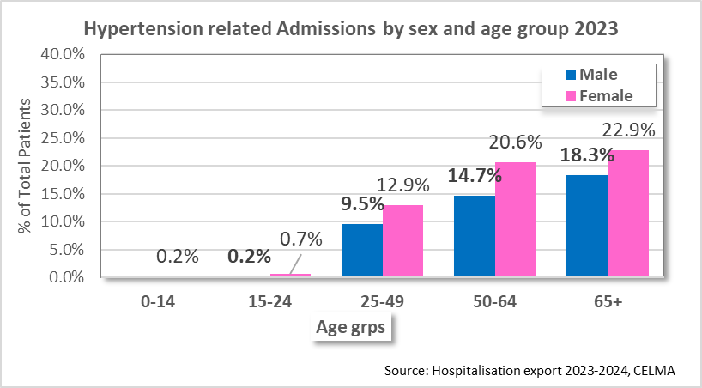
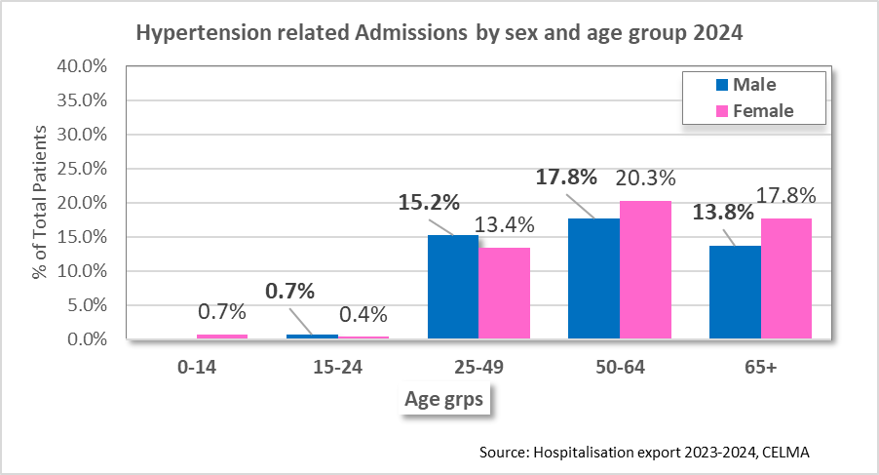
Morbidity (Hospital Admissions 2023 and 2024) -Admissions by Date for Predominant reasons for Hospitalization
Hypertension
Hypertension related admissions averaged 35 and 23 per month for 2023 and 2024 resp.
Occurred at a rate of 3 per 100 admissions for 2023 and 2024 respectively.
More females than males were admitted for each year (63% and 58% resp.)

Slide 19
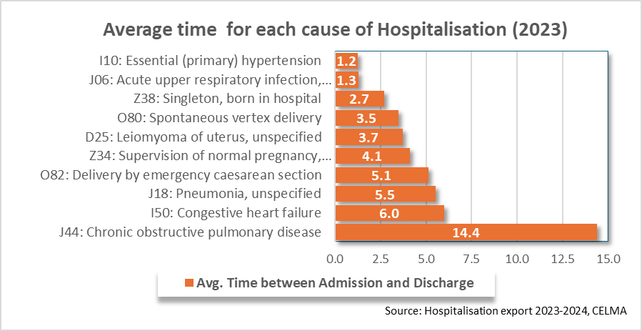
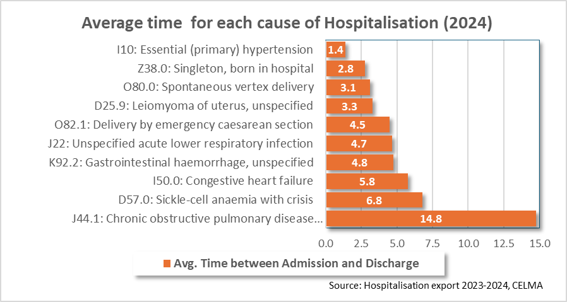
Morbidity (Hospital Admissions 2023 and 2024) Admissions Days/Patient Days
COPD ranked number 1 with patients averaging admission of 14 days in 2023, and 15 days in 2024

Slide 20
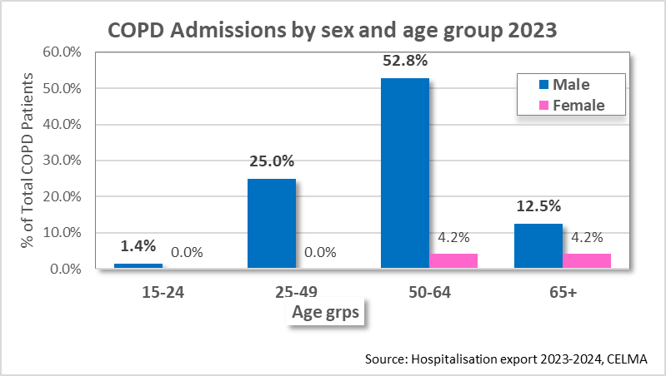
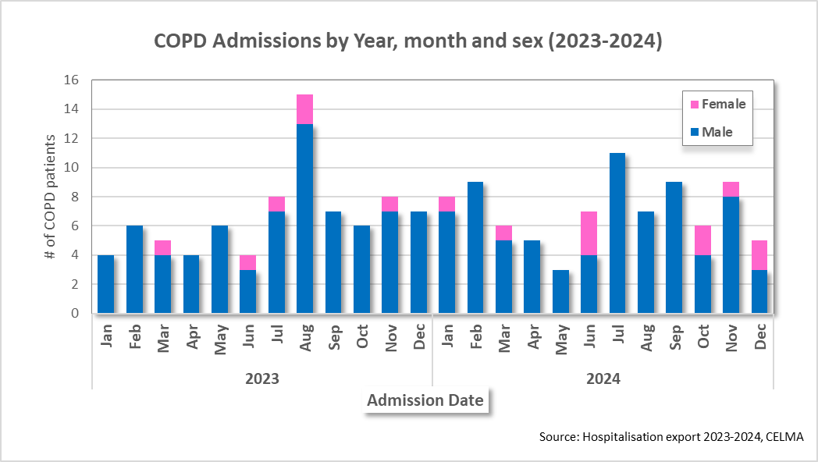
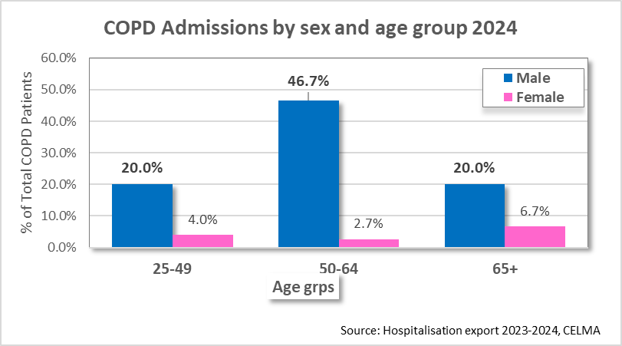
Morbidity (Hospital Admissions 2023 and 2024) Admission days - Closer look at COPD
A total of 72 and 75 cases of COPD (avg. 7 cases per month resp.) were recorded for 2023 and 2024 resp.
In 2024, accounted for 871 total admission days with an avg of 15 days admission time.
Males accounted for 92% in 2023 and 87% in 2024
Highest percentage of cases are in the 50-64 age grp (57%)

Slide 21
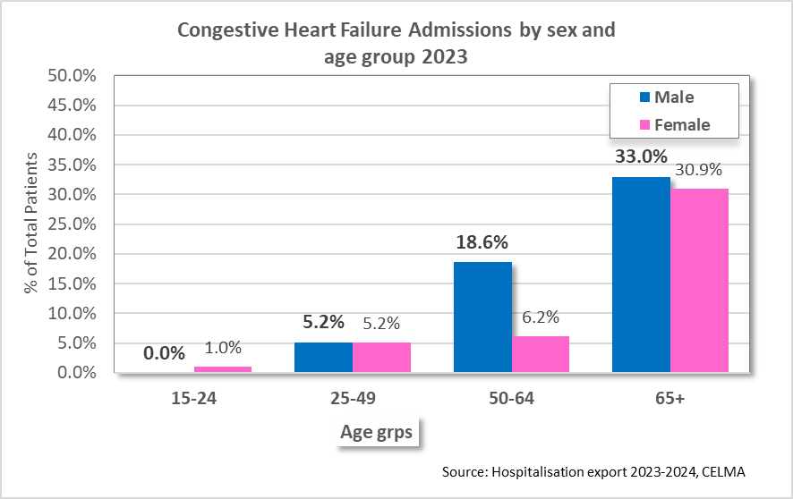
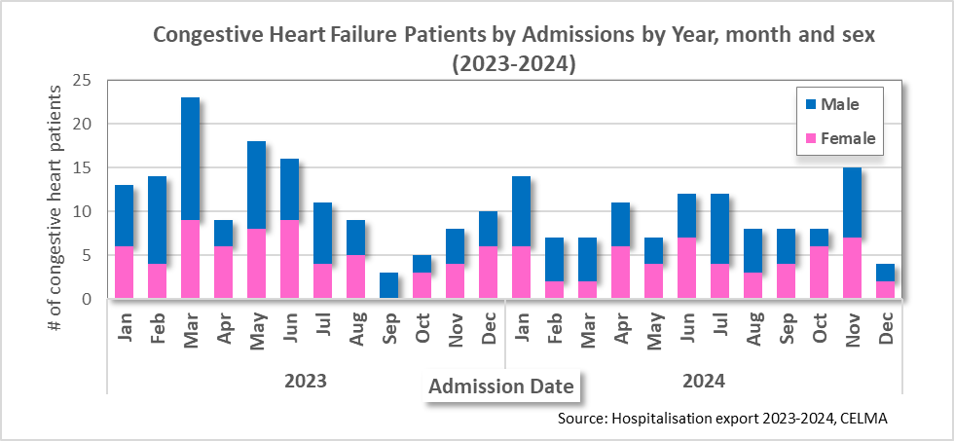
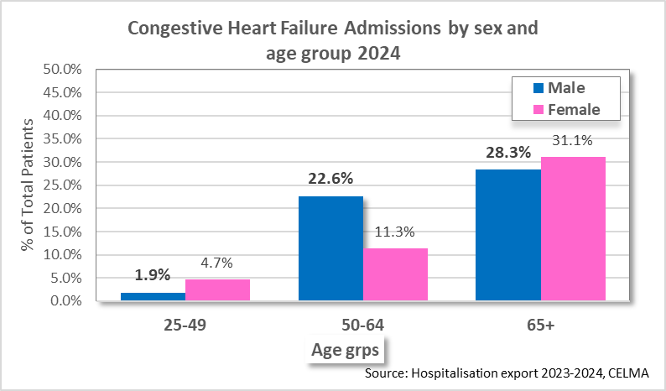
Morbidity (Hospital Admissions 2023 and 2024) Admission days - Closer look at Congestive Heart Failure (CHF)
A total of 128 and 106 cases of CHF (avg. 12 and 9 cases per month resp.) were recorded for 2023 and 2024 resp.
In 2024, accounted for 491 total admission days with an avg of 6 days admission time.
Males accounted for 55% in 2023 and 53% in 2024
Highest percentage of cases are in the 65+ age grp (59%)

Slide 22
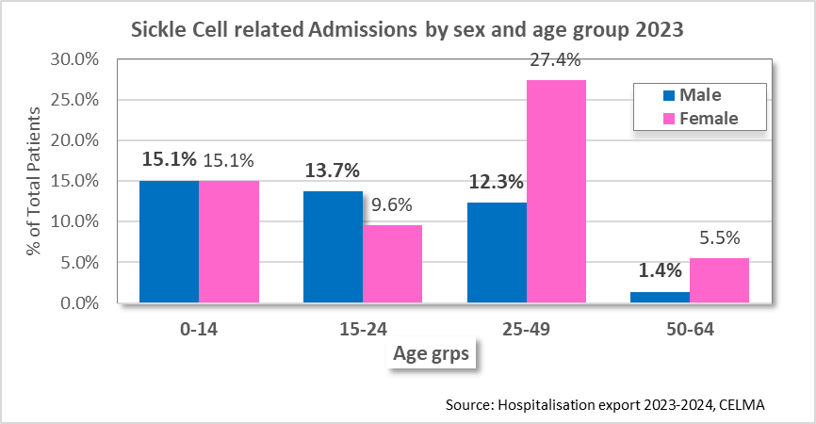
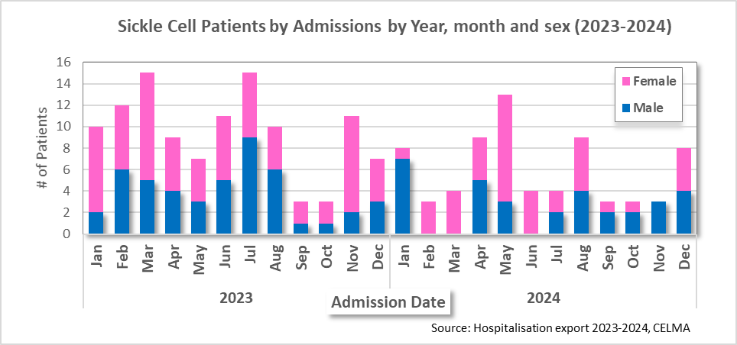
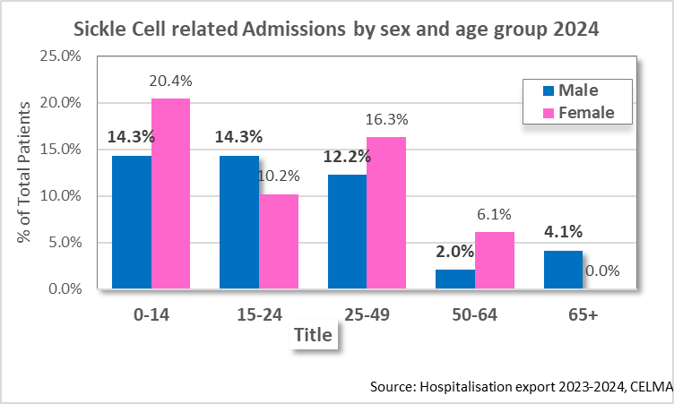
Morbidity (Hospital Admissions 2023 and 2024) Admission days - Closer look at Sickle Cell Disease
A total of 73 and 49 cases of Sickle cell (avg. 9 and 6 cases per month resp.) were recorded for 2023 and 2024 resp.
Highest % of cases for 2023 are in the 25-49 age grp (40%)
Highest % of cases for 2024 are in the 0-14 age grp (35%)
Females accounted for 58% in 2023 and 53% in 2024
In 2024, accounted for 467 total admission days with an
avg of 6 days admission time.

Slide 23
Morbidity: Cancer Incidence (2020 – 2024)
Top 5 new cancer Diagnoses by year.
Rank | 2020 | 2021 | 2022 | 2023 | 2024
1 | Prostate | Breast | Prostate | Prostate | Prostate
2 | Breast | Prostate | Breast | Breast | Breast
3 | Skin | Skin | Cervix Uteri | Colon | Skin
4 | Colon | Cervix Uteri | Skin | Skin | Cervix Uteri
5 | Cervix Uteri | Colon | Stomach, Colon | Corpus Uteri | Stomach, Colon
Total New Cases | 280 | 220 | 288 | 395 | 269
Notes:
Skin cancer: Ultra violet rays of the sun, certain pesticides

Slide 24
Morbidity: Communicable diseases
Communicable Disease (# of new cases) | 2008 | 2009 | 2010 | 2011 | 2012 | 2013 | 2014 | 2015 | 2016 | 2017 | 2018 | 2019 | 2020 | 2021 | 2022 | 2023 | 2024
COVID-19 |  |  |  |  |  |  |  |  |  |  |  |  | 378 | 13,595 | 15,788 | 517 | 58
Dengue | 105 | 19 | 97 | 749 | 35 | 282 | 92 | 33 | 62 | 57 | 102 | 20 | 1322 | 39 | 16 | 60 | 432
Leptospirosis | 4 | 4 | 17 | 30 | 11 | 29 | 14 | 8 | 11 | 24 | 29 | 35 | 1 | 5 | 7 | 10 | 15
Influenza A | - | 10 | - | 5 | 29 | 2 | 15 | - | 13 |  | 11 | 19 | 5 | - | - | 33 | 45
Influenza B | 2 | - | 2 | - | - | 1 | - | - | 1 | - | 5 | - | 1 | - | - | 9 | 2
RSV | - | - | 15 | 37 | 5 | 1 | - | 3 | 14 | 9 | 39 | 2 | - | - | - | 53 | 2
Rhinovirus | - | - | - | - | 20 | 20 | 1 | 2 | 1 | 19 | 20 | 18 | - | - | 2 | - | -
Leprosy | - | - | - | 1 | - | - | 2 | - | - | - | - | - | 5 | 10 | 9 | 15 | 1
Rotavirus |  |  |  |  |  |  |  | 17 |  | 3 | 3 | 2 |  |  |  | 6 | 1
Adenovirus |  |  |  |  |  |  |  | 2 | 2 | 13 | 6 | 1 | 1
Tuberculosis | - | - | - | - | - | - | - | 1 | - | - | - | 3 | 8 | 3 | 2 | 3 | 1
Source: Case Notifications, Epidemiology Unit, MoH

Slide 25
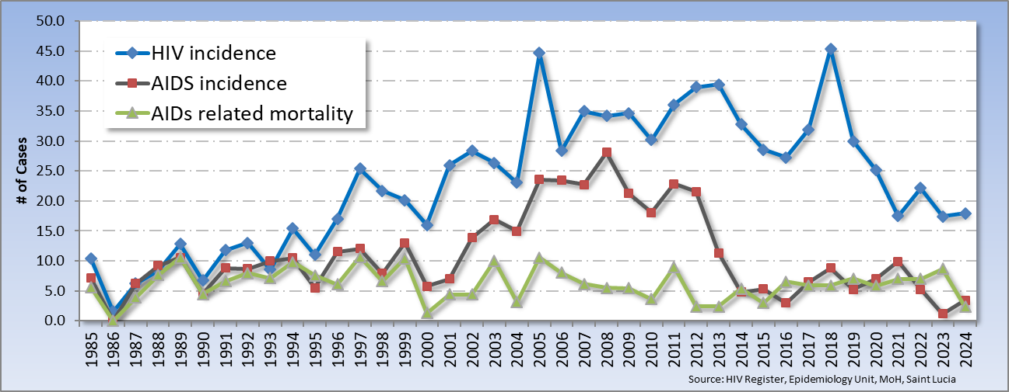
HIV & AIDS analysis morbidity & Mortality
ARVs introduced in 2006

Slide 26
Risk Factors

Slide 27
Risk factors
Risk Factor | Both | Male | Female
Tobacco Use Current daily tobacco smokers | 8.5 | 16.8 | 2.1
Alcohol Consumption Percentage who currently drink (drank alcohol in the past 30 days) Percentage who engage in heavy episodic drinking (6 or more drinks on any occasion in the past 30 days) | 61.9 19.1 | 72.3 28.8 | 53.9 11.6
Diet Ate less than 5 servings of fruit and/or vegetables on average per day | 83.2 | 81.7 | 84.3
Physical Activity Insufficient physical activity (defined as < 150 minutes of moderate intensity activity per week, or equivalent)* | 17.1 | 13.9 | 19.5
Cervical cancer and breast cancer screening Women aged 50-69 years who have never had a mammography Women who have never had a breast exam Women aged 30-49 years who have ever had a screening test for cervical cancer |  |  | 58.8 19.3 80.8
Saint Lucia STEPS Survey, 2019

Slide 28
Risk factors
Risk Factor | Both | Male | Female
Mean Body Mass Index (BMI) | 28.4 | 26.1 | 30.2
Percentage who are overweight or obese (BMI ≥ 25 kg/m²) | 65.0 | 50.0 | 76.8
Percentage who are obese (BMI ≥ 30 kg/m²) | 34.9 | 20.6 | 46.1
Percentage with raised total cholesterol (≥ 190 mg/dl or currently on medication for raised cholesterol) | 31.9 | 23.4 | 38.5
Percentage with raised BP, not previously diagnosed | 37.3 | 52.8 | 26.0
Percentage with raised BP, previously diagnosed, not currently on medication | 22.5 | 21.8 | 23.1
Percentage with raised BP, previously diagnosed, currently on medication, not controlled | 26.1 | 18.1 | 31.9

Slide 29
Mortality
Leading Causes of Death
Infant Mortality

Slide 30
Top 10 Leading Causes of Death (1989 – 2022)
From 1989 – 1999, Heart diseases was #1 cause of death
From the year 2000- 2022, malignant neoplasms has been the #1 cause of death, with the exception of 2005, where it ranked #3
From 1989, Heart Diseases, Strokes and cancers have been constantly in the top 5.
From 1989 to 2022, we can appreciate the movement of Chronic Lower Respiratory Diseases up the ranks in mortality.
In 2020, Mental health entered the top 10 causes for the first time
Chronic Liver Disease & cirrhosis have been almost constant
Source: Mortality Database, Epidemiology Unit, MoH, Saint Lucia
RANK | 1989 | 1995 | 2000 | 2005 | 2010 | 2015 | 2020 | 2021 | 2022
1 | Heart diseases (I05-I09, I20-I52) | Heart diseases (I05-I09, I20-I52) | Malignant neoplasms (C00-C97) | E10-E14: Diabetes mellitus | C00-C97: Malignant neoplasms | C00-C97: Malignant neoplasms | C00-C97: Malignant neoplasms | C00-C97: Malignant neoplasms | C00-C97: Malignant neoplasms
2 | Cerebrovascular disease (I60-I69) | Malignant neoplasms (C00-C97) | Heart diseases (I05-I09, I20-I52) | I10-I15: Hypertensive diseases | I05-I09; I20-I52: Heart diseases | I60-I69: Cerebrovascular diseases | I60-I69: Cerebrovascular diseases | I05-I09; I20-I52: Heart diseases | I60-I69: Cerebrovascular diseases
3 | Malignant neoplasms (C00-C97) | Cerebrovascular disease (I60-I69) | Diabetes mellitus (E10-E14) | C00-C97: Malignant neoplasms | E10-E14: Diabetes mellitus | I05-I09; I20-I52: Heart diseases | I05-I09; I20-I52: Heart diseases | U00-U85: COVID-19 | I05-I09; I20-I52: Heart diseases
4 | Accidents & adverse effects (V01-X59) | Diabetes mellitus (E10-E14) | Cerebrovascular disease (I60-I69) | I60-I69: Cerebrovascular diseases | I60-I69: Cerebrovascular diseases | E10-E14: Diabetes mellitus | E10-E14: Diabetes mellitus | I60-I69: Cerebrovascular diseases | E10-E14: Diabetes mellitus
5 | Hypertensive disease (I10-I15) | Accidents & adverse effects (V01-X59) | Accidents & adverse effects (V01-X59) | I05-I09; I20-I52: Heart diseases | I10-I15: Hypertensive diseases | I10-I15: Hypertensive diseases | I10-I15: Hypertensive diseases | E10-E14: Diabetes mellitus | U00-U85: Covid-19
6 | Pneumonia & influenza (J10-J18) | Conditions originating in perinatal period (P00-P96) | Conditions originating in perinatal period (P00-P96) | J09-J18: Influenza and pneumonia | X85-Y09: Assault | J40-J47: Chronic lower respiratory diseases | J40-J47: Chronic lower respiratory diseases | J40-J47: Chronic lower respiratory diseases | J40-J47: Chronic lower respiratory diseases
7 | Diabetes mellitus (E10-E14) | Hypertensive disease (I10-I15) | Homicide (X85-Y09) | Ill-defined and unknown cause of mortality | J40-J47: Chronic lower respiratory diseases | P00-P96: Perinatal conditions | X85-Y09: Assault | Q00-Q99: Congenital anomalies | X85-Y09: Assault
8 | Conditions originating in perinatal period (P00-P96) | Chronic liver disease & cirrhosis (K70, K73, K74) | Hypertensive disease (I10-I15) | J40-J47: Chronic lower respiratory diseases | P00-P96: Perinatal conditions | K70-K74: Chronic liver disease and cirrhosis | J09-J18: Influenza and pneumonia | K70-K74: Chronic liver disease and cirrhosis | K70-K74: Chronic liver disease and cirrhosis
9 | Bronchitis, emphysema & asthma (J40-J46) | Bronchitis, emphysema & asthma (J40-J46) | Bronchitis, emphysema & asthma (J40-J46) | X85-Y09: Assault | K70-K74: Chronic liver disease and cirrhosis | J09-J18: Influenza and pneumonia | V01-V89: Land transport accidents | X85-Y09: Assault | P00-P96: Perinatal conditions
10 | Chronic liver disease & cirrhosis (K70, K73, K74) | Homicide (X85-Y09) | Pneumonia & influenza (J10-J18) | Other bacterial diseases | J09-J18: Influenza and pneumonia | O00-O99: Maternal causes of mortality | F00-F99: Mental, behavioral disorders | V01-V89: Land transport accidents | J09-J18: Influenza and pneumonia

Slide 31
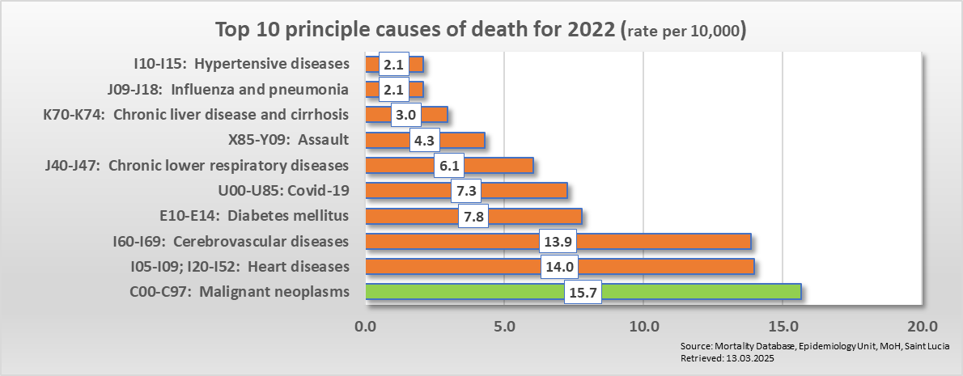
Principal causes of deaths in 2022
In 2021, deaths due to COVID-19 ranked 3rd however, in 2022 as the outbreak declined it moved to 5th place giving way to the usual top four causes of death which has dominated in Saint Lucia: Cancer, Heart Disease, Cerebrovascular(stroke) Disease, and Diabetes .
In 2022, 1590 deaths were recorded; 959 male & 631 female.
The top 10 leading causes of death accounted for about 81% of the total deaths in Saint Lucia for 2022.
NCD’s accounted for 76% of all deaths for 2022, a 5% increase from the previous year.
The top 4 principal causes of death which are CNCD’s accounted for 55% of all deaths.
Communicable diseases do not present as a significant cause of death and accounted for 13% of all deaths in 2022, approx. 6% less than the previous year.
The rate of Assault doubled from the previous year.
.
Top 10 Leading Causes of Death for 2022 (per 10, 000)
Source: Mortality Database, Epidemiology Unit, MoH, Saint Lucia

Slide 32
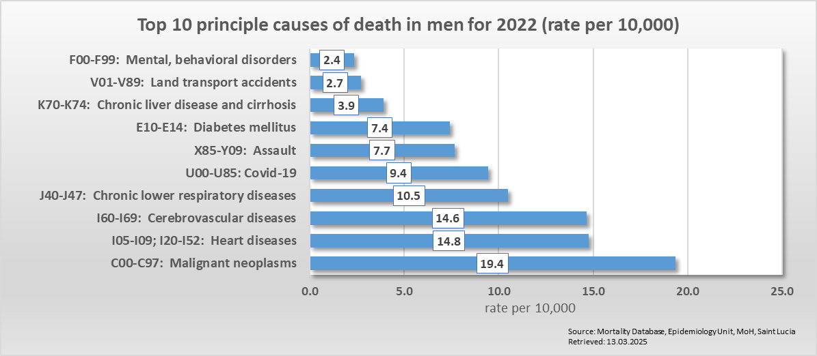
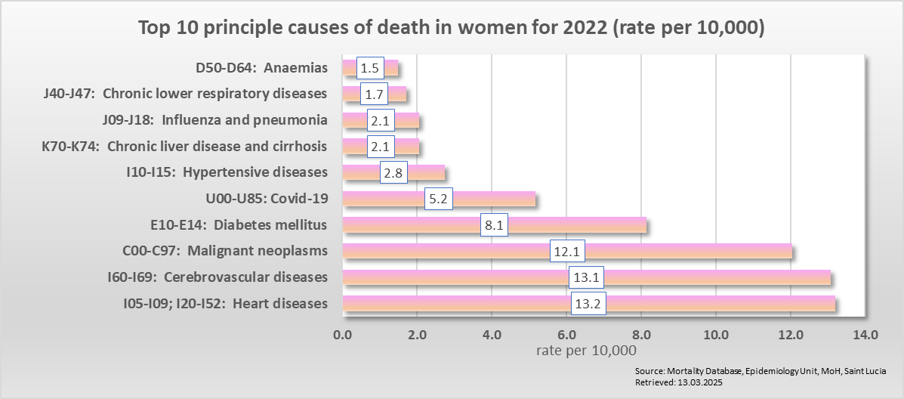
Cause of death by sex (2022)
The top 3 causes of death were the same for both males and females, however in different order.
COVID-19 ranked at #5 for both sexes.
Chronic lower respiratory diseases and assault ranked higher among males compared to diabetes among females.
Important to note the presence of land transport accidents and mental & behavioral disorders among males and not females.
Top 10 Leading Causes of Death in Males for 2022 (per 10, 000)
Top 10 Leading Causes of Death in Females for 2022 (per 10, 000)
2022

Slide 33
Total Mortality-Years of Potential Life Lost (2022)
A total of 17,552 Years of Potential Life was lost in 2022.
Assault (3132 YPLL) ranked at number 1, accounting for 18% of total YPLL.
Cancers (2872 YPLL) ranked number 2 accounting for 16%.
Chronic Lower Resp. Disease (1773 YPLL) accounted for 10% of total YPLL of which 80% were due to COPD.
Years of Potential Life Lost due to Principal Causes of Death (2022)
Source: Mortality Database 2022, Epidemiology
Source: Mortality Database, Epidemiology Unit, MoH, Saint Lucia
Notes:
"Years of Potential Life Lost" (YPLL) refers to the number of years of life lost due to premature death, typically calculated by subtracting the age at death from a predetermined benchmark age (usually 75). It's a measure of premature mortality and helps quantify the social and economic impact of deaths occurring at younger ages.
Why Use YPLL? Measuring premature death rather than overall death focuses on deaths that could have been prevented

Slide 34
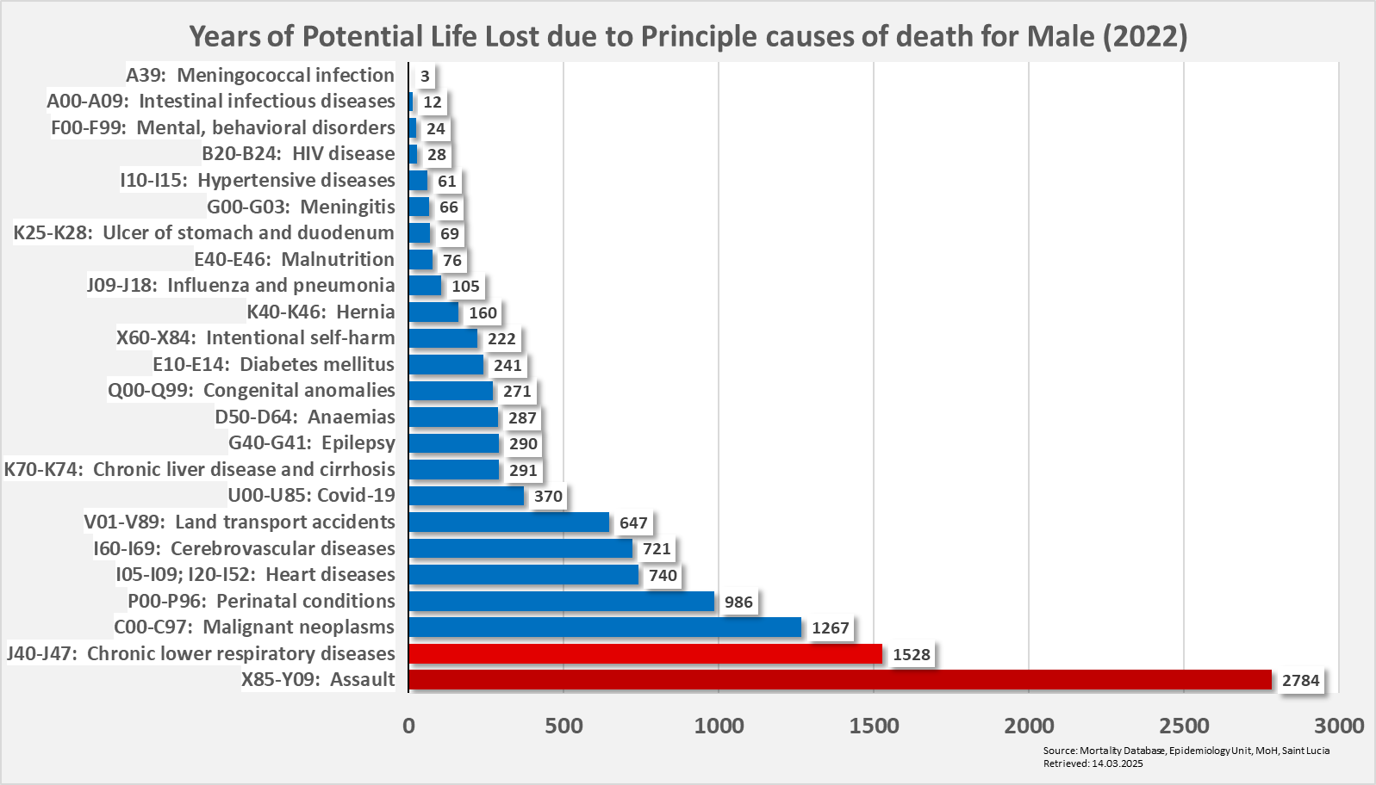
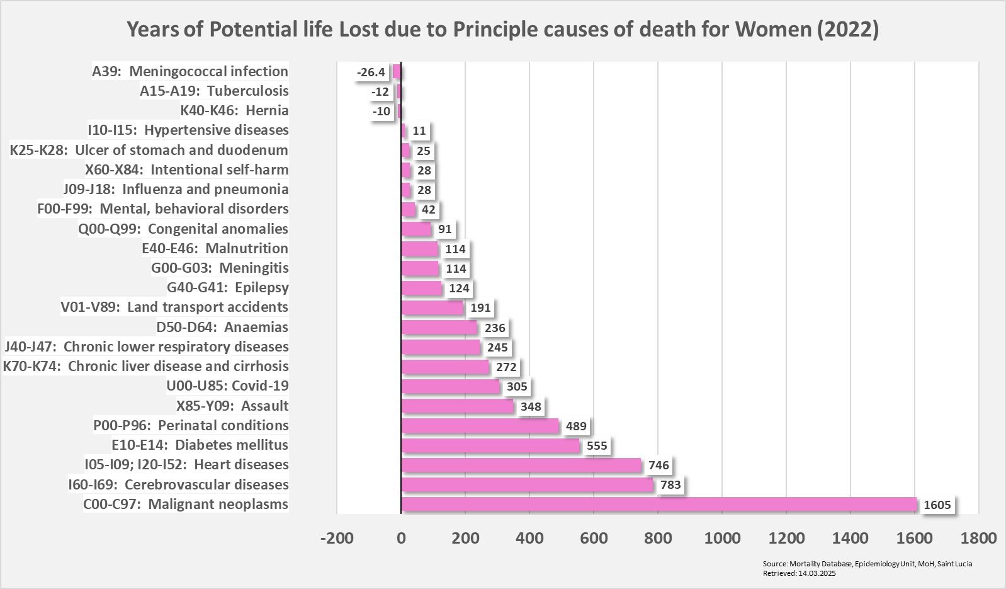
Total Mortality-Years of Potential Life Lost (YPLL) by Sex (2022)
Males Lost A total of 11,247 of Potential Life
Assault accounted for 25% of YPLL
Chronic Lower Respiratory Diseases accounted for 14% of YPLL
Of which 78% was due to COPD
Years of Potential Life Lost due to Principal Causes of Death for Males (2022)
Years of Potential Life Lost due to Principal Causes of Death for Females (2022)
Females Lost A total of 6,305 of Potential Life
Cancer accounted for 26% of YPLL
The top 4 CNCD’s accounted for 59%
Source: Mortality Database, Epidemiology Unit, MoH, Saint Lucia

Slide 35
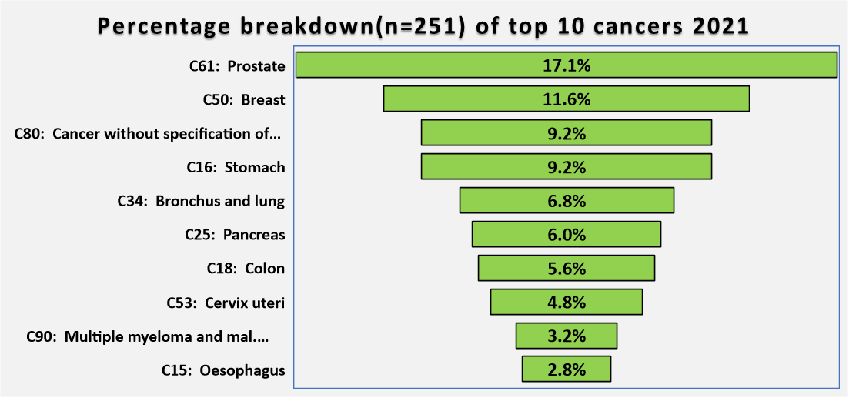
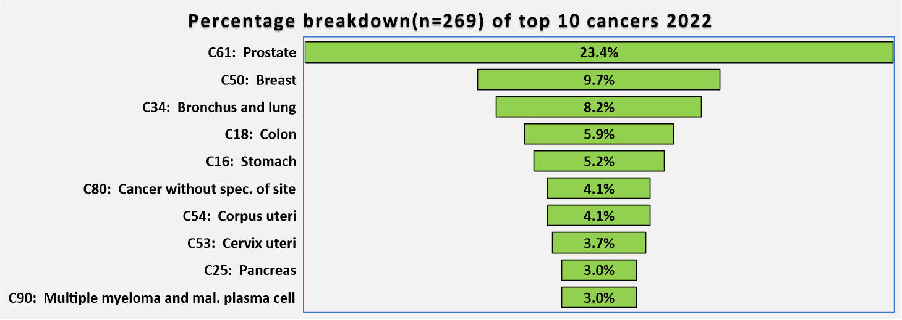
Cancer mortality
Cancers account for about 17% of the total deaths for both 2021 and 2022.

Slide 36
Cancer mortality by sex
Between 2017-2022, cancer accounted for almost 1/5 (20%) of total deaths.

Slide 37
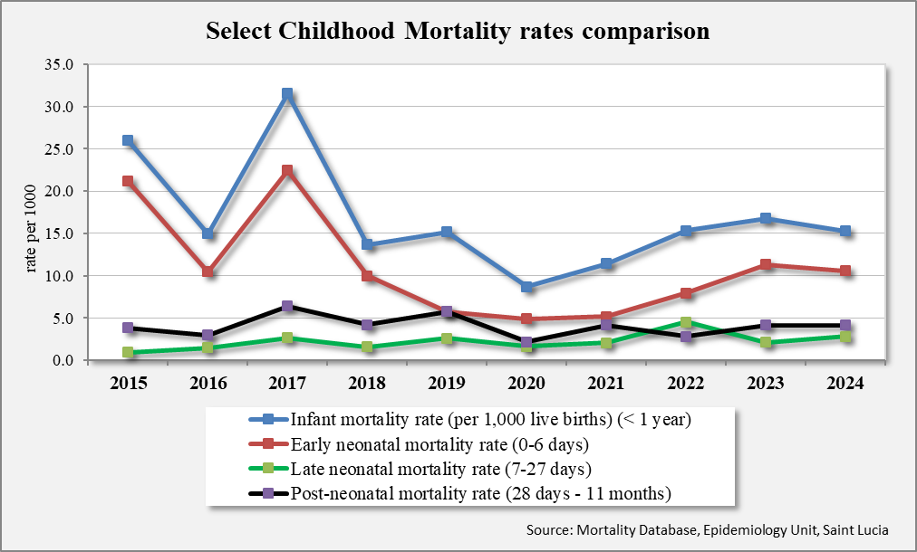
Infant mortality rate
The infant mortality rate (IMR) is the number of deaths of infants (<1 year old) per 1,000 live births. The rate is often used as an indicator of the level of health in a country.
Trends in IMR, Early, Late and Post Neonatal rates per 1,000 live births per year, 2015 to 2024
NB: 2023-2024 rates are forecasted

Slide 38
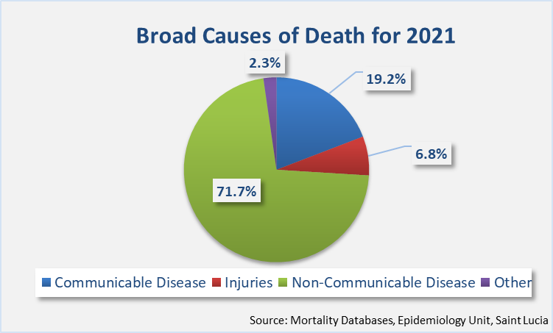
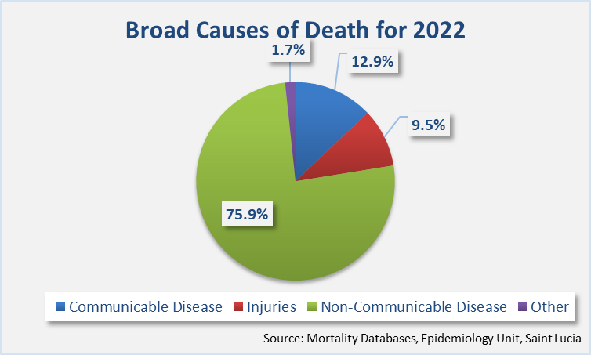
Broad Causes

Slide 39
Thank you for your attention……..

