Slide 1
General Overview of Health in Saint Lucia
Dr. Sharon Belmar- George B.Sc. MD MPH
Chief Medical Officer
Ministry of Health, Wellness and Elderly Affairs
May 22, 2025

Slide 2
Outline
Health Sector Vision and Mission
Structure of National Health System
Health Sector Departments
Health Sector Collaboration and cooperation
Population Structure and Implications
Main Population Risk Factors
Morbidity and Mortality
Health Sector Strengths
Health Sector Weaknesses
Work Program Priorities

Slide 3
Health Sector Vision: To obtain optimal wellness within the entire population by increasing access to affordable good quality health care.
Health sector mission: To lead through advocacy, policy direction, regulation, delivery of accessible comprehensive quality health and social services using the most cost effective mechanisms.
To achieve this the health sector will create and maintain a healthy environment that promotes gender equity and encourages personal responsibility for well-being through the building of alliances and partnerships, sharing of knowledge and skills development.
National Strategic Plan for health (2006-2011)

Slide 4
Mission: To provide leadership and direction in the creation of an environment in which empowered institutions can be created, guided and nurtured for provision of holistic health and social services to the entire population of Saint Lucia
STRATEGIC PRIORITIES:
Comprehensive integrated model of care for all aged groups and care management programmes
Strengthen Border Safety through implementation of the International Health Regulations (Port Health Programme)
Accreditation of health facilities and medical schools
Strengthen response to disease outbreaks and mass casualties
2024/25 Estimates of Revenue and Expenditure

Slide 5
Structure of the National Health System

Slide 6
Distribution of Health Services
2 Statutorized Hospitals
(MHMC, SJH)
1 Private Hospital (Tapion)
2 Polyclinics (Gros-Islet and Betty Wells)
2 District Hospitals (Dennery and Soufriere)
34 Wellness Centers

Slide 7
Departments in Health
Agency Administration
Corporate Planning
Finance and Budget
Health Management information System
Universal Health Coverage
Elderly Care Unit
Public Health Unit

Slide 8
Public Health Departments
Office of the CMO
Epidemiology Unit
Primary Health Care: 34 Wellness Centers, 2 polyclinics, 2 Community hospitals
Pharmacy Services
Dental Services
Infectious Disease
Chronic Disease
Health Education
Nutrition Unit
Environmental Health
Substance Abuse Advisory Secretariat

Slide 9
Primary Healthcare Unit
The primary health care forms part of the wider network of public and private health systems, which delivers health care at the community level to where people live, work and play.
The primary health care is led by the Chief Medical Officer, and the Principal Nursing Officer has overall oversight of the provision and delivery of primary care services at the primary health care facilities.
The primary care facilities provide health care that is affordable, accessible and equitable to all individuals and families using a life course approach.
A range of prevention, promotive, treatment and support services are provided across four levels of care, however there are different levels of resources and complexity at each level. Each level is expected to provide health services within specific functions and scope of responsibilities for a defined catchment area.

Slide 10
Services Provided within Primary Health Care
Maternal Health
Child Health
Diabetes and hypertension screening and management to include podiatry
Cancer screening (breast, cervical, testicular, prostate)
Sexual and reproductive health
Dental assessments and treatment
Dermatology to include Hansens
Obstetrics/gynecology
Colposcopy
Immunizations – child and adult
Medical consultations and treatment
Internal Medicine
Nephrology
Pharmacy
Mental health
Nutritional
Eye care to include diabetic retinopathy
Chronic self-management program
Hearing health and psychiatry
Men’s Health
Home visits and outreach
Health Education/ promotion
Health fairs

Slide 11
Health Collaboration
Pan American Health Organization
Caribbean Public Health Agency
Organization of Eastern Caribbean States
World Health Organization
World Pediatrics
US Medical Military Missions
Martinique
Cuba

Slide 12
Population by Age and Gender, 2022 (census)
 | Males |  | Females |  | Total
 | No | % | No | % | No | %
<1 | 923 | 0.5% | 839 | 0.5% | 1762 | 1.0%
1-4 | 4,117 | 2.4% | 3,997 | 2.3% | 8114 | 4.7%
5-14 | 11,268 | 6.6% | 11,179 | 6.5% | 22,448 | 13.1%
15-24 | 11,889 | 6.9% | 11,363 | 6.6% | 23,252 | 13.5%
25-44 | 25,001 | 14.5% | 26,291 | 15.3% | 51,293 | 29.9%
45-64 | 22,023 | 12.8% | 22,362 | 13.0% | 44,385 | 25.8%
65 or Older | 9,493 | 5.5% | 11,089 | 6.5% | 20,581 | 12.0%
Total | 84714 | 49.3% | 87120 | 50.7% | 171834 | 100.0%
Notes:
Census 2022 has estimated the population of Saint Lucia to be 171,834 for 2022. Females comprise 49.3% and women of child-bearing age (15-44 years) about 22%. Children (<15 years) represent about 19% and the elderly (65 years or older) 12%.

Slide 13
Population by District and Gender (2022)
District | Male | Female | Total | %Total
Anse La Raye | 5464 | 5251 | 10715 | 6.2%
Babonneau | 6943 | 7026 | 13971 | 8.1%
Canaries | 993 | 934 | 1927 | 1.1%
Castries | 23217 | 24088 | 47308 | 27.5%
Choiseul | 3536 | 3609 | 7142 | 4.2%
Dennery | 6475 | 6469 | 12945 | 7.5%
Gros Islet | 11630 | 13019 | 24657 | 14.3%
Laborie | 4242 | 4248 | 8491 | 4.9%
Micoud | 8191 | 8461 | 16656 | 9.7%
Soufriere | 4244 | 4080 | 8321 | 4.8%
Vieux Fort | 9781 | 9924 | 19707 | 11.5%
Total | 84714 | 87120 | 171834 | 100.0%

Slide 14
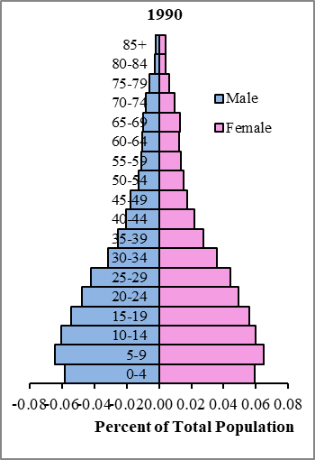
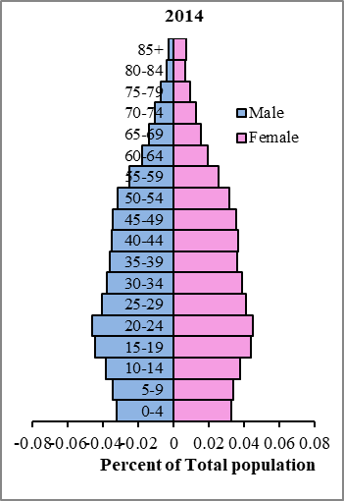
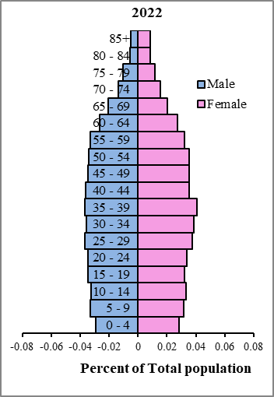
Population Pyramid

Slide 15
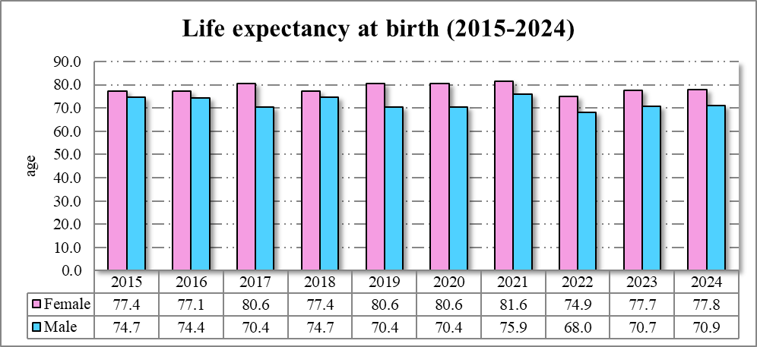
Life expectancy by sex
Source: Epidemiological Trend Indicators Database, Epi Unit, Saint Lucia

Slide 16
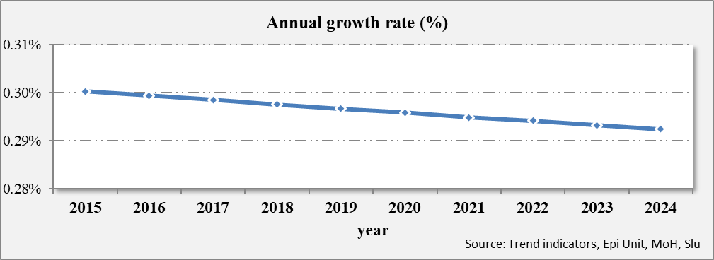
Saint Lucia Population growth rate
Trends in Crude Birth Rates (CBRs) and Crude Death Rates (CDRs), 2015 - 2024
Annual growth rate of mid-year population, 2011 to 2020
Source: Epidemiology Unit, MoH, Saint Lucia

Slide 17
Fertility
Replacement fertility is the TFR at which women give birth to enough babies to sustain population levels; replacement fertility should be approximately 2.1
Replacement level
Source: Epidemiology Unit, MOH, Saint Lucia

Slide 18
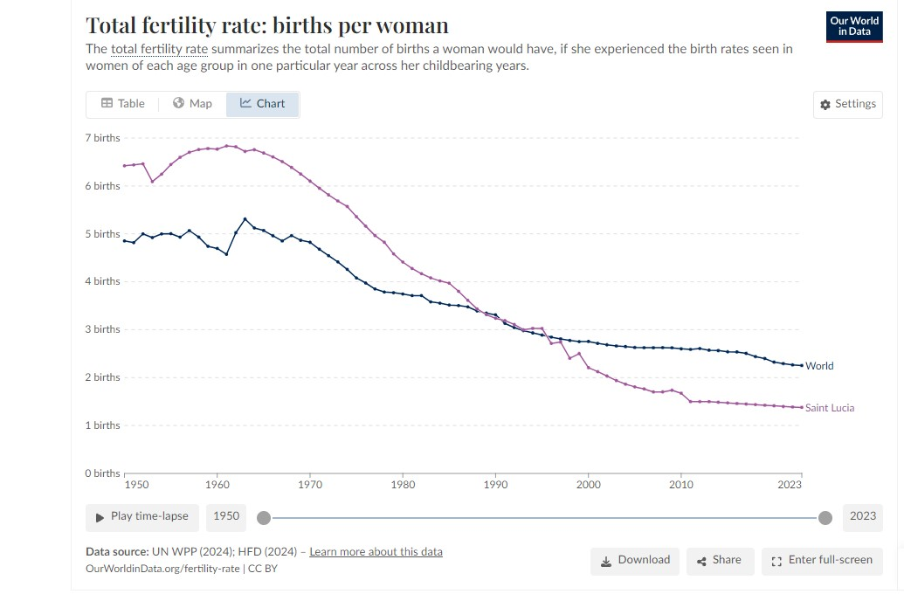
Total Fertility Rate – Global & Local

Slide 19
Our Future Population

Slide 20
Economic Impact of Population Decline
Labor shortages: less of the working age population to fill jobs, especially for skilled labor
Reduced Economic Growth: production is reduced by reduced work force
Increased Dependency Ratio: reduced workers supporting an aging population, greater strain on NIC, public sector healthcare and pension systems
Declined Consumer Demand: less workers, less spenders on goods and services leading to economic stagnation

Slide 21
Social Impact of Population Decline
Aging population: increasing demand for healthcare and elderly care services
School closures and shrinking communities: rural areas may become deserted as persons move to the cities
Infrastructure maintenance: fewer taxpayers lead to reduced government revenue for maintenance of roads, public services and utilities

Slide 22
Risk factors
Risk Factor | Both | Male | Female
Tobacco Use Current daily tobacco smokers | 8.5 | 16.8 | 2.1
Alcohol Consumption Percentage who currently drink (drank alcohol in the past 30 days) Percentage who engage in heavy episodic drinking (6 or more drinks on any occasion in the past 30 days) | 61.9 19.1 | 72.3 28.8 | 53.9 11.6
Diet Ate less than 5 servings of fruit and/or vegetables on average per day | 83.2 | 81.7 | 84.3
Physical Activity Insufficient physical activity (defined as < 150 minutes of moderate intensity activity per week, or equivalent)* | 17.1 | 13.9 | 19.5
Cervical cancer and breast cancer screening Women aged 50-69 years who have never had a mammography Women who have never had a breast exam Women aged 30-49 years who have ever had a screening test for cervical cancer |  |  | 58.8 19.3 80.8
Saint Lucia STEPS Survey, 2019

Slide 23
Risk factors
Risk Factor | Both | Male | Female
Mean Body Mass Index (BMI) | 28.4 | 26.1 | 30.2
Percentage who are overweight or obese (BMI ≥ 25 kg/m²) | 65.0 | 50.0 | 76.8
Percentage who are obese (BMI ≥ 30 kg/m²) | 34.9 | 20.6 | 46.1
Percentage with raised total cholesterol (≥ 190 mg/dl or currently on medication for raised cholesterol) | 31.9 | 23.4 | 38.5
Percentage with raised BP, not previously diagnosed | 37.3 | 52.8 | 26.0
Percentage with raised BP, previously diagnosed, not currently on medication | 22.5 | 21.8 | 23.1
Percentage with raised BP, previously diagnosed, currently on medication, not controlled | 26.1 | 18.1 | 31.9

Slide 24
Morbidity (Primary Care)
2022 | 2023 | 2024
Essential (primary) hypertension | Acute upper respiratory infection, unspecified | Essential (primary) hypertension
Issue of repeat prescription | Essential (primary) hypertension | Acute upper respiratory infection, unspecified
Acute upper respiratory infection, unspecified | Issue of repeat prescription | Issue of repeat prescription
Schizophrenia, unspecified | Acute nasopharyngitis [common cold] | Non-insulin-dependent diabetes mellitus, without complications
Non-insulin-dependent diabetes mellitus, with other specified complications | Diarrhea and gastroenteritis of presumed infectious origin | Diarrhea and gastroenteritis of presumed infectious origin
Urinary tract infection, site not specified | Urinary tract infection, site not specified | Acute nasopharyngitis [common cold]
Low back pain | Acute tonsillitis, unspecified | Urinary tract infection, site not specified
Examination of ears and hearing | Non-insulin-dependent diabetes mellitus, without complications | Non-insulin-dependent diabetes mellitus, with other specified complications
General medical examination | Cough | Low back pain
Diarrhoea and gastroenteritis of presumed infectious origin | Unspecified acute lower respiratory infection | General medical examination

Slide 25
Morbidity: other communicable diseases
Top 10 most common communicable disease presenting in Saint Lucia
Communicable Disease (# of new cases) | 2015 | 2016 | 2017 | 2018 | 2019 | 2020 | 2021 | 2022 | 2023 | 2024
Covid-19 |  |  |  |  |  | 378 | 13595 | 15788 | 517 | 58
Dengue | 33 | 62 | 57 | 102 | 20 | 1322 | 39 | 16 | 60 | 432
Leptospirosis | 8 | 11 | 24 | 29 | 35 | 1 | 5 | 7 | 10 | 15
Influenza A |  | 13 |  | 11 | 19 | 5 |  |  | 33 | 45
RSV | 3 | 14 | 9 | 39 | 2 |  |  |  | 53 | 2
Rhinovirus | 2 | 1 | 19 | 20 | 18 |  |  | 2
Leprosy |  |  |  |  |  | 5 | 10 | 9 | 15 | 1
Rotavirus | 17 |  | 3 | 3 | 2 |  |  |  | 6 | 1
Adenovirus | 2 | 2 | 13 | 6 | 1 | 1
Tuberculosis | 1 |  |  |  | 3 | 8 | 3 | 2 | 3 | 1

Slide 26
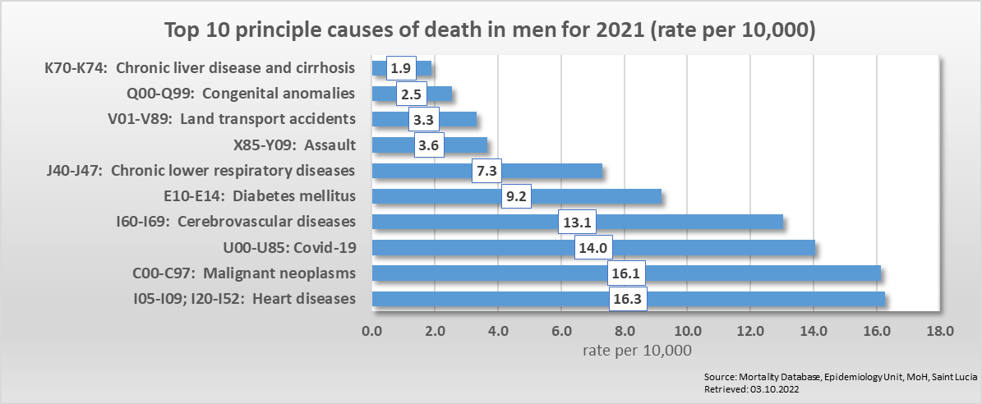
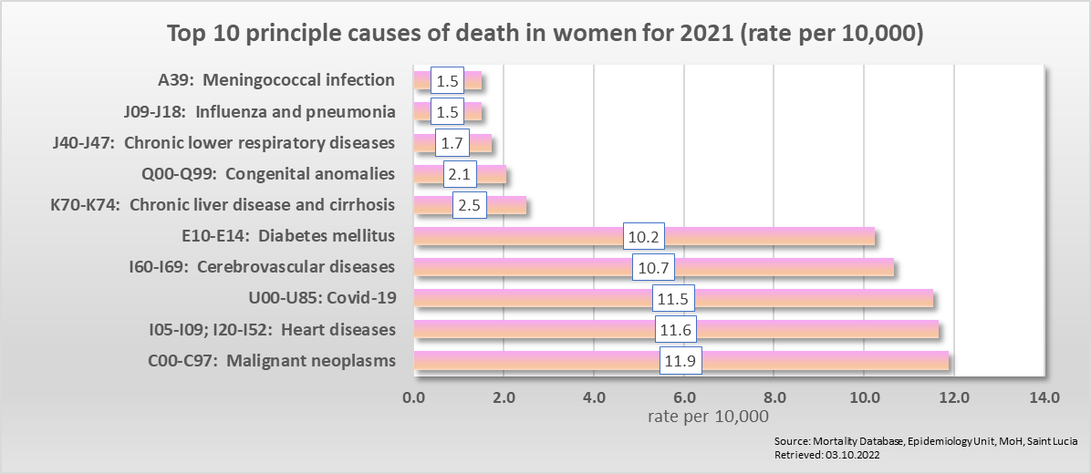
Cause of death by sex

Slide 27
Strengths
Political Will: scope for further development- Policy Direction
Universal Health Coverage Policy
Comprehensive Network of Wellness Centres across island
State of the Art Public Hospital
Fair Dedicated Well trained Health Human Resource Available
International and Regional Networks: WPP, Sick Kids, Martinique, Cuba, Kids in Sight, DRP-Queens Jubilee Fund
International and Regional Public Health Support: PAHO, WHO, CARPHA, OECS, Martinique, Taiwan
Health Management Information System
Strong Epidemiology Unit: Data analysis
Strengthened Public Health System: Lab, Ports, Surveillance

Slide 28
Weaknesses/Challenges
Human Resource Deficit: Nursing, Pharmacy, Medical Speciality
Lack of Defined Health Financing Mechanism
Burden of Disease: CNCDs, CD, Mental Health,
Aging Plant and Equipment: SJH, WC,
Lack of a Standardised National Health Management Information System
Gap Between Health Resources and Expressed Needs
Referral System between Primary and Secondary Care/ Public and Private Sector
Pre- Hospital care/ Emergency transportation system
Lack of a Comprehensive Quality Management System: Licensing of Health Services etc.

Slide 29
Work Program Priorities
Quality Initiative
Universal Health Coverage
General Strengthening of Primary Care Services/ Focus on Preventative Care
National Cancer Program
National Blood Bank
Human Resource for Health (Retention strategies for Nurses, Pharmacists, Specialist Training)
Sexual Health Program
Drug Use And Abuse
Expansion of Services: Dental/ Specialist Services in Primary Care
Mental Health Program Strengthening
Food Import/Export Bill
Infection Prevention and Control
Public Health Strengthening

Slide 30
Questions??

